Slide 1


Association of Indians for Self-Determination
in Healthcare
July 24, 2026
Elliott Milhollin
Hobbs, Straus, Dean & Walker LLP

Slide 2
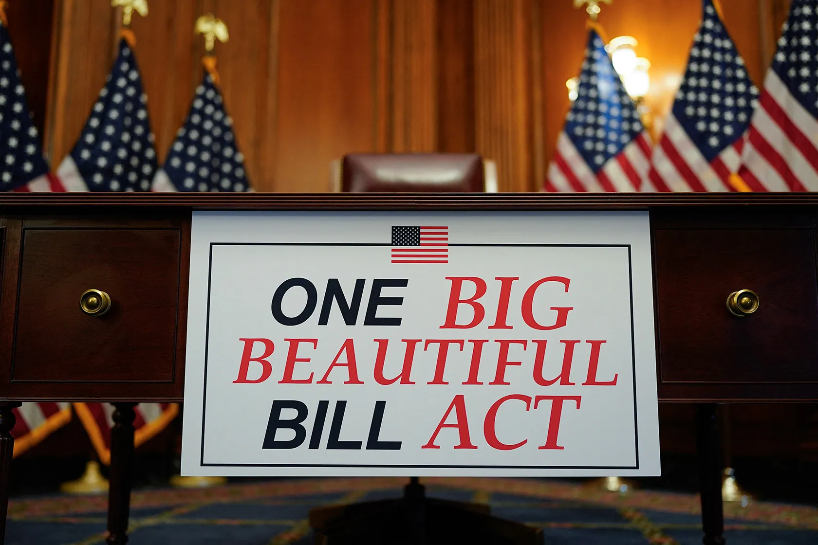
The One Big Beautiful Bill Act
On July 3, 2025, Congress passed H.R.1, the “One Big Beautiful Bill Act.”
In general, the bill:
  reduces taxes,
  enacts reforms that will shrink Medicaid and SNAP,
  raises the debt ceiling by about $4 trillion,
  creates the Rural Hospital Transformation Program, and
  rescinds parts of the Inflation Reduction Act.

Slide 3
Medicaid Reform
The One Big Beautiful Bill Act implements several reforms to the Medicaid program. AI/ANs are largely exempt from those changes.
Medicaid Reform | General Impact | Tribal Exemption
Community Engagement | Beneficiaries must work or enroll in school at least part-time to maintain their coverage. | AI/ANs do not have to comply with work requirements.
Six-Month Redeterminations | Beneficiaries will have their eligibility evaluated every six months, rather than annually. | Annual redeterminations are preserved for AI/ANs.
Increased Cost-Sharing | Beneficiaries over 100% federal poverty level will have increased cost-sharing responsibility. | AI/ANs remain exempt from all cost-sharing.

Slide 4
Provider Taxes
The bill limits states’ ability to levy provider taxes.
  The bill phases down provider taxes by 0.5% annually in states that have expanded Medicaid until it reaches 3.5% in 2031.
  States that have not expanded Medicaid would have their provider taxes frozen at current rates.

Slide 5
Provider Taxes
States have used provider taxes to increase their revenue and expand the services they can cover.
By capping the ability to tax providers, States may be forced to reduce the services or populations they cover. This could then limit the services that Tribal facilities can bill Medicaid for.
Tribes can work with their states to exempt Tribal facilities from any reductions in coverage.
Federal Funds
State Funds
Provider Taxes
Federal Funds
State Funds
Provider Taxes

Slide 6
Medicaid Community Engagement Requirements – Interim Final Rule
Issued June 3, 2026, and effective July 31, 2026
Implements the new community engagement requirements, including the AI/AN exemption:
  States must use existing sources of information, including eligibility systems, to verify AI/AN identity before requesting information from beneficiaries.
  States should use existing Medicaid verification processes to verify AI/AN identity for community engagement requirements.
  States should refrain from reverifying AI/AN identity once established.
  States must conduct significant outreach to beneficiaries.

Slide 7
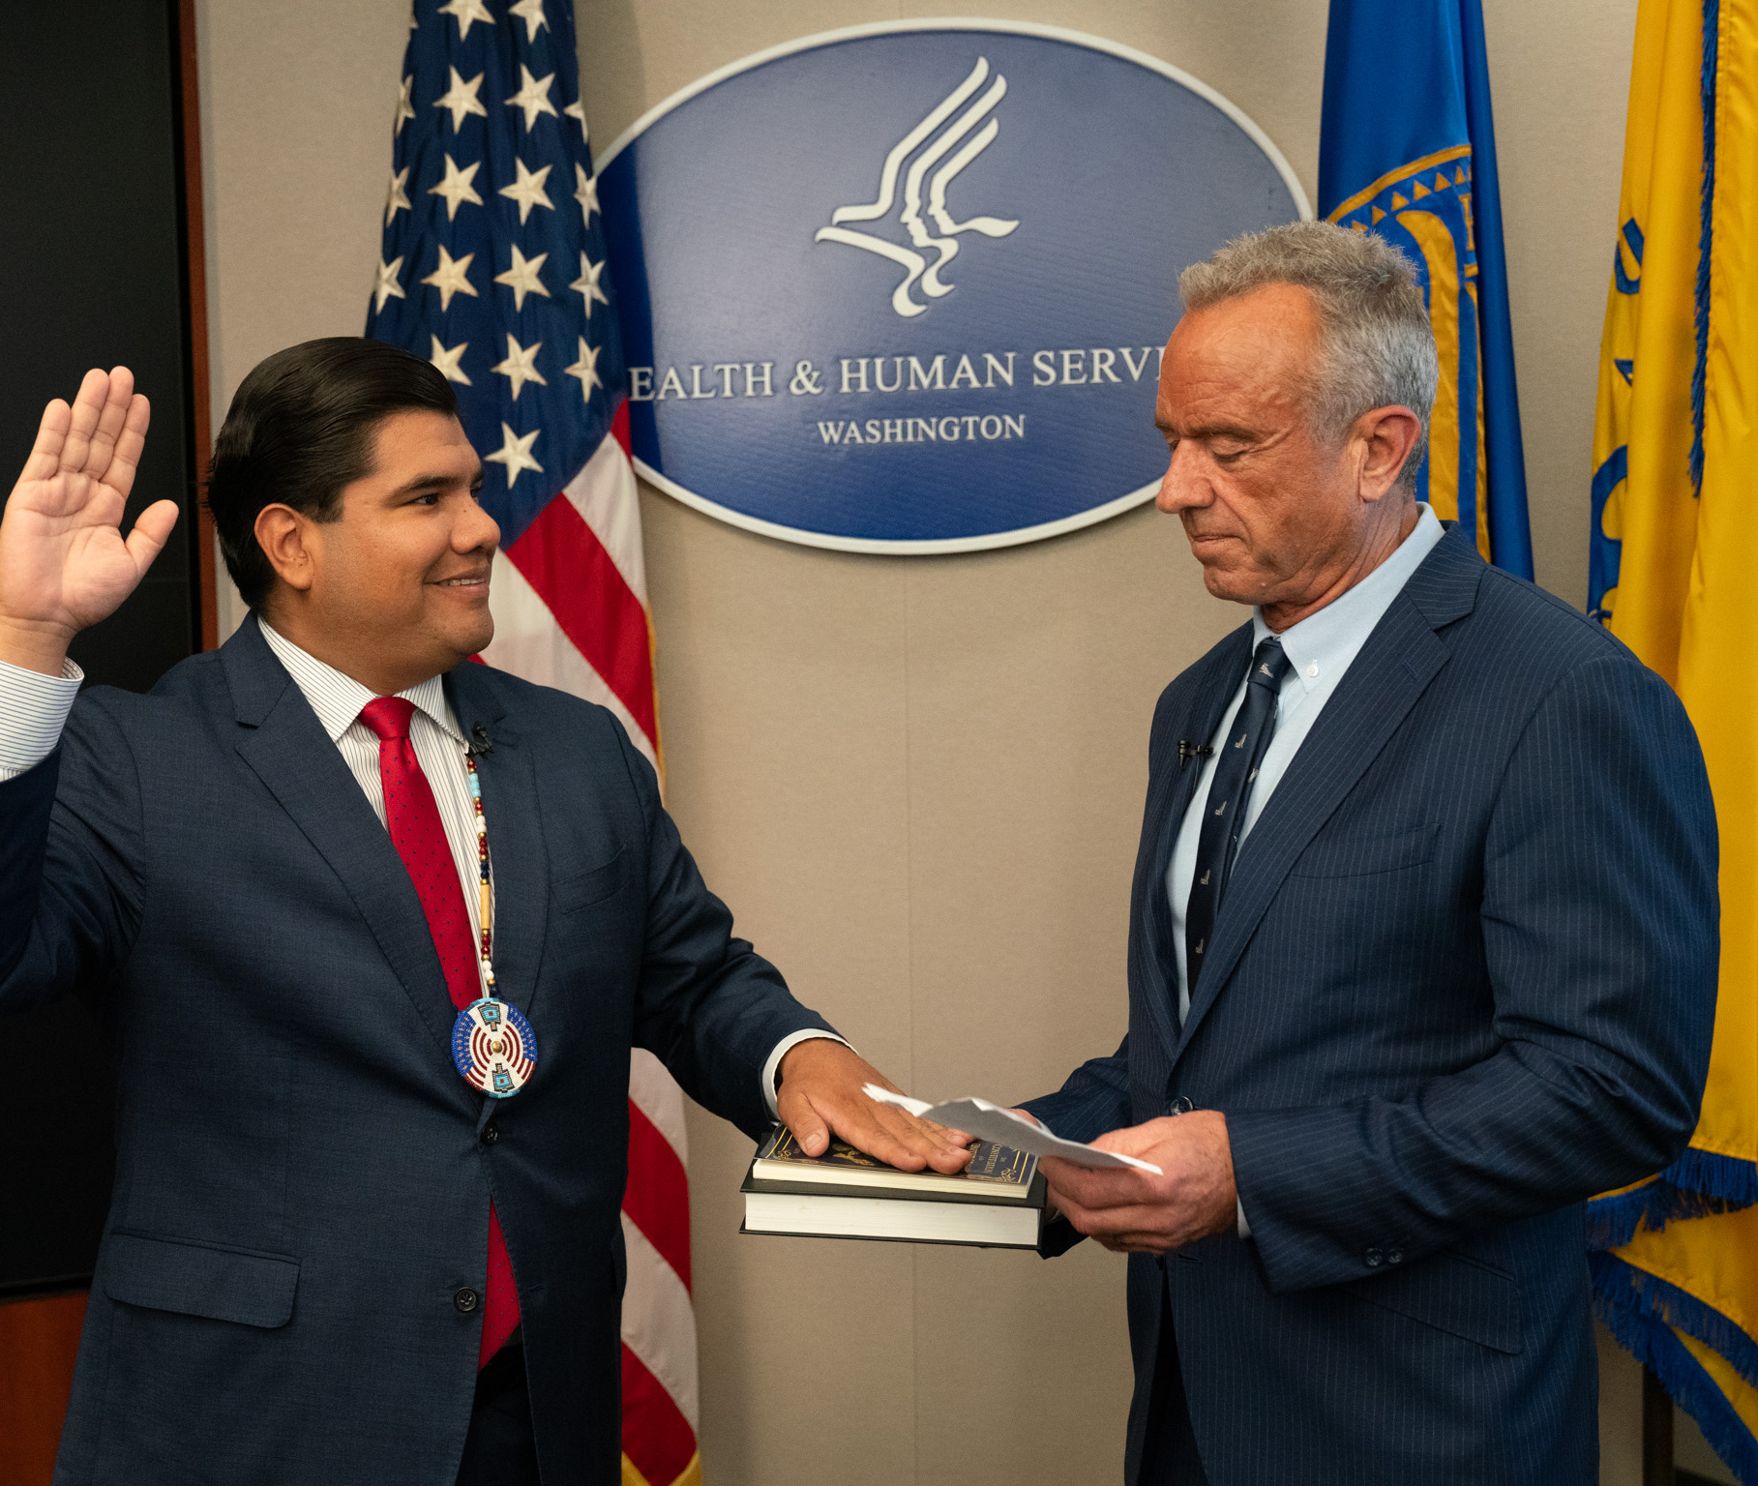
Mark Cruz Nominated to be IHS Director
On June 1, 2026, Mark Cruz was nominated to be Director of the Indian Health Service (IHS).
Mr. Cruz currently serves as Senior Advisor to Secretary of Health and Human Services Robert F. Kennedy Jr. He has indicated that he will continue in his role as Senior Advisor along with IHS Director.

Slide 8
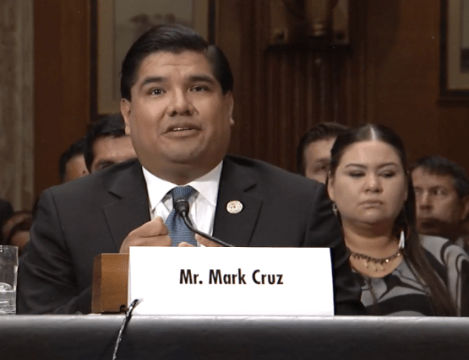
Mark Cruz Nominated to be IHS Director
The Senate Committee on Indian Affairs held Mr. Cruz’s nomination hearing on June 24, 2026. On July 22, 2026, the Committee held a markup and advanced Mr. Cruz’s nomination to the Senate floor.
Throughout the hearing, Mr. Cruz:
  Emphasized collaboration with Congress and Tribal leaders
  Characterized Tribal consultation as an ongoing process
  Expressed support for strengthening coordination across
  Stated his primary focus on improving patient care and Tribal health outcomes.

Slide 9
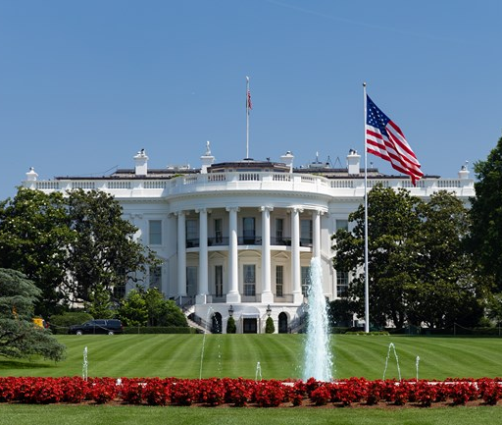
FY2027 Appropriations – President’s Budget Request
In general, the President’s Budget Request proposes modest increases or flat funding for all IHS accounts.
The request also includes advance appropriations for FY 2028.
  This is an improvement over last year’s request, which failed to request advance appropriations.

Slide 10
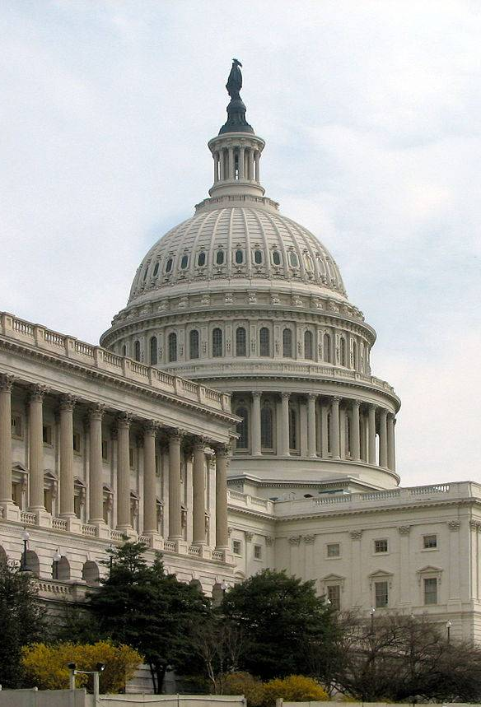
FY2027 Appropriations – Congress
The House has released its Interior-Environment Appropriations Bill, which passed out of the full House Appropriations Committee on June 3, 2026.
For the IHS, it provides $8.7 billion for IHS, including prior-year advance appropriations.
  This is an increase of $640 million above the enacted level.
The bill would also provide $6.1 billion in FY 2028 advance appropriations.
Finally, it provides full funding for CSC and section 105(l) leases.
The Senate has not yet released any of its appropriations bills, including for the IHS. This is due to a dispute over defense spending.

Slide 11
FY2027 Appropriations – Congress
The House and Senate are nowhere near a compromise on appropriations, even as the fiscal year is set to end on September 30, 2026.
We expect that Congress will have to enact a continuing resolution to keep the government funded beyond the September 30 deadline to avoid a shutdown.
  Under this scenario, most government agencies will continue to operate at FY 2026 enacted levels until Congress passes a full-year appropriations bill.
  The IHS will be largely shielded from disruptions because of advance appropriations.
  Those accounts that do not receive advance appropriations (Electronic Health Records, the Indian Health Care Improvement Fund, Sanitation Facilities Construction, and Health Care Facilities Construction) would be funded by the continuing resolution.

Slide 12
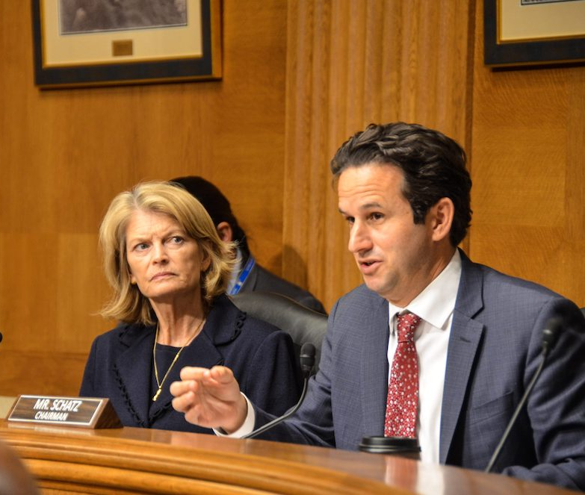
Native Children’s Bill
On July 14, 2026, Senators Lisa Murkowski (R-AK) and Brian Schatz (D-HI) introduced the “Native Children’s Commission Implementation Act of 2026,” S.4976.
The bill implements many of the recommendations of the 2024 Alyce Spotted Bear and Walter Soboleff Commission on Native Children Report.
The scope of the bill is expansive and includes several Tribal health provisions.

Slide 13
Native Children’s Bill
Health provisions include, but are not limited to:
Codify TACs and Tribal Affairs Offices across HHS
Tribal Perinatal Workforce Grants
Tribal Set-Aside for the Community Mental Health Services Block Grant
Tribal Set-Aside for Substance Use Prevention, Treatment, and Recovery Services Block Grant
Self-Governance at SAMHSA
Self-Governance Pilot for SNAP Administration
Tribal Schools Nutrition Grant Pilot Program
Establish a BIE Behavioral Health and Wellness Program
Improve Tribal Data Collection at CDC
Study the Intersection of Domestic Violence and Maternal Mortality
Study the Intersection of Nutrition Programs and Health Outcomes
Study the Impact of Environmental Health on Native Children

Slide 14
Questions?
Elliott Milhollin
Email: emilhollin@hobbsstraus.com
Phone: (202) 822-8282

